Slide 1

TrojanSync
Sync Smarter, Collaborate Easier: The Trojan Way
Team D7
Chihkai Liao, Angela Sun, Sri Vaishnavi Arza, Yukti Tandon
09/27/2025

Slide 2


THE MARKET NEED
TrojanSync
A unified platform is needed to reduce friction and enable efficient collaboration.
Pain Point:
Coordination Challenges
74% of students face difficulties in coordination
Behavioral Insight:
Scattered tools
90% of students face challenges integrating tools such as 12Twenty, EngageSC, and Brightspace
Solution Demand
97% of students believe AI-generated meeting time suggestions are helpful

Slide 3
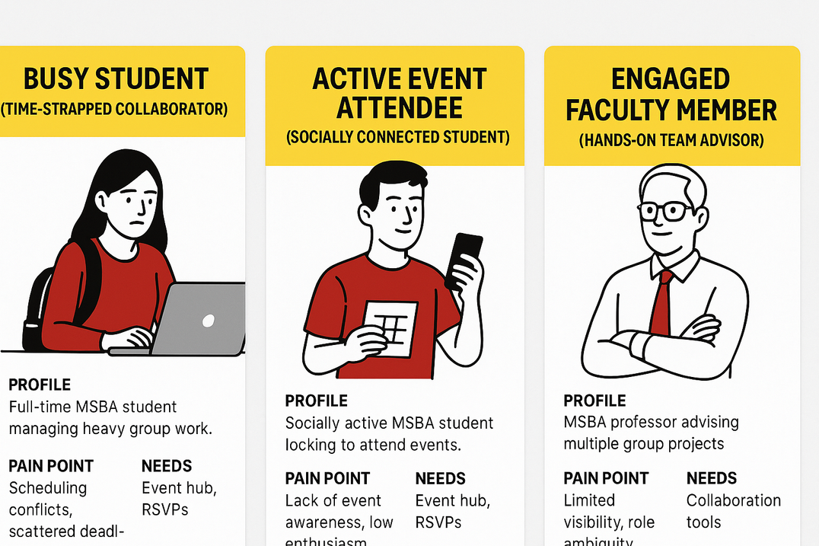
PERSONA & INSIGHTS
TrojanSync
Busy Collaborator
Event Seeker
Community Builder
7-person project check-in this week
Conflicting schedules, unclear roles
Career/school events
“Should I go?”
Friday social mixer
Scattered chats, last-minute location changes, lagged email communication

Slide 4
IDEATION TO FOCUS
01
Decisions and Strategy
Explore multiple options
Chosen direction
Interview MSBA students
Build a simple app that helps the MSBA community improve productivity, collaborate easily and form a strong community
02
Features Decision
Features In: calendar, teams, voice channel
Features out: notes section, template use/creation
03
Design
Figma
Website design / Phone design
TrojanSync

Slide 5





SOLUTION OVERVIEW
TrojanSync
TrojanSync
plan, attend, align
Productivity
Collaboration
Community
Streamline scheduling and stay on top of tasks with an all-in-one smart calendar that helps you plan efficiently
Coordinate seamlessly with classmates and teams through shared events, reminders, and group planning tools
Build a stronger Trojan network by connecting with students through shared interests, events, and opportunities

Slide 6



MVP SCOPE
TrojanSync
Team Calendar
Voice Channel
Team Setting
Share and Sync within teams
AI integration to find optimal meeting times with availability
RSVP to events and see who’s going
Color-coded teams/projects for easy differentiation
MSBA community channel
Individual team channel
Create your own channel
Enables not only academic collaboration but also social interaction
Join teams with your unique team codes
Team matching based on projects, skills, and schedules

Slide 7
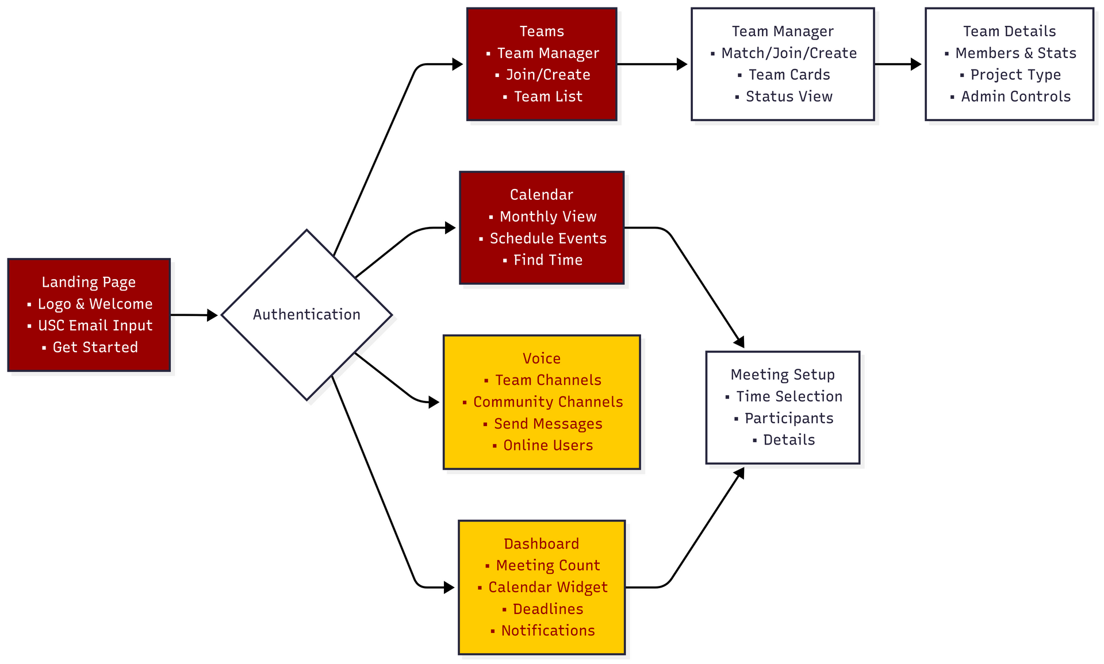
HOW TROJANSYNC WORKS
TrojanSync

Slide 8
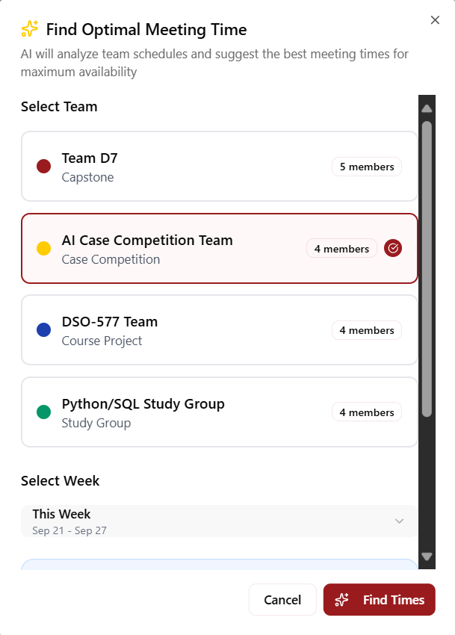
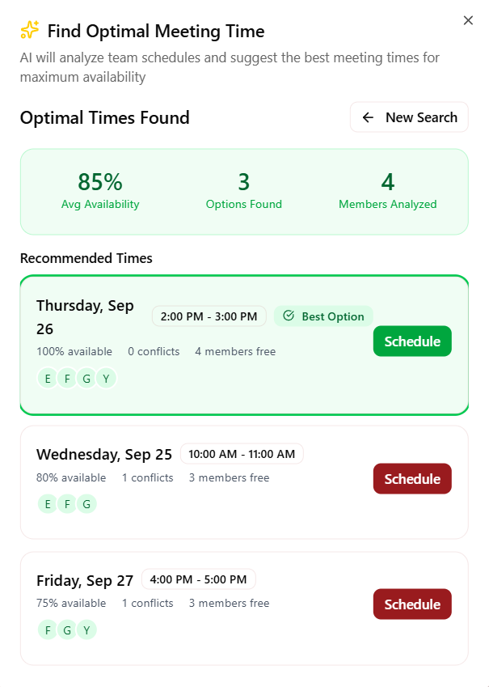

FEATURE 1 DEMO
Smart Schedule : Find optimal time within seconds!
Thynk Unlimited
TrojanSync

Slide 9
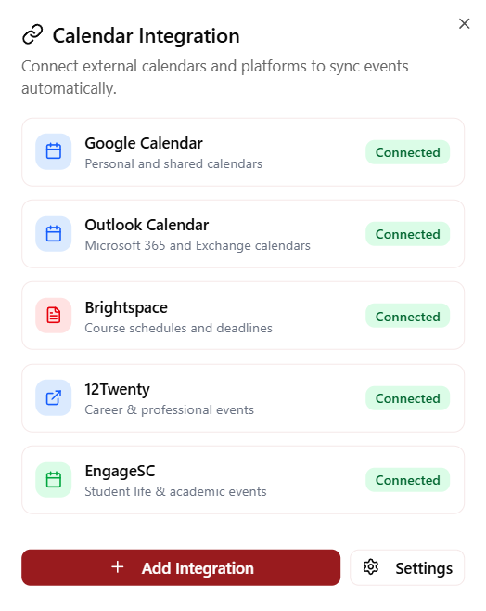
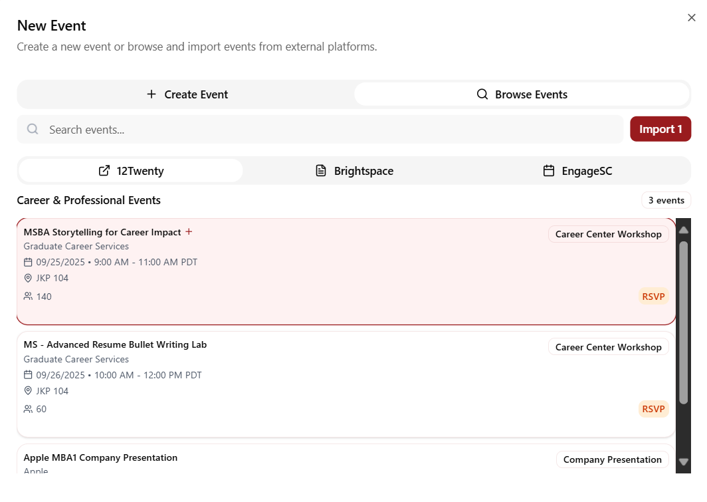
FEATURE 2 DEMO
Event Hub : Everything in one place!
Thynk Unlimited
TrojanSync

Slide 10
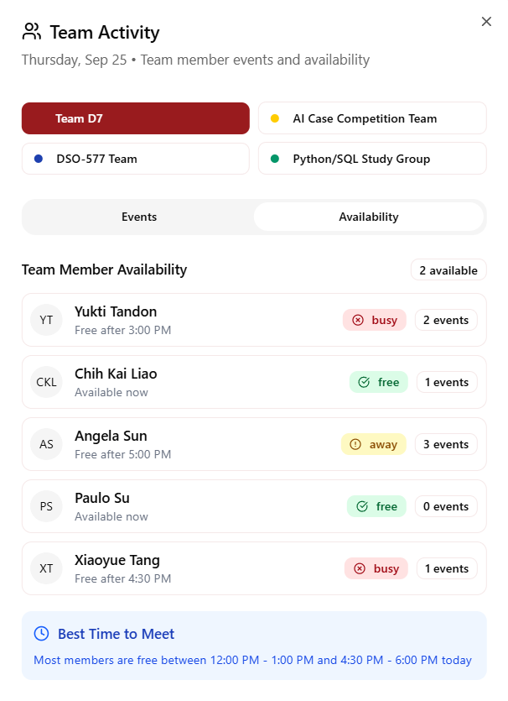
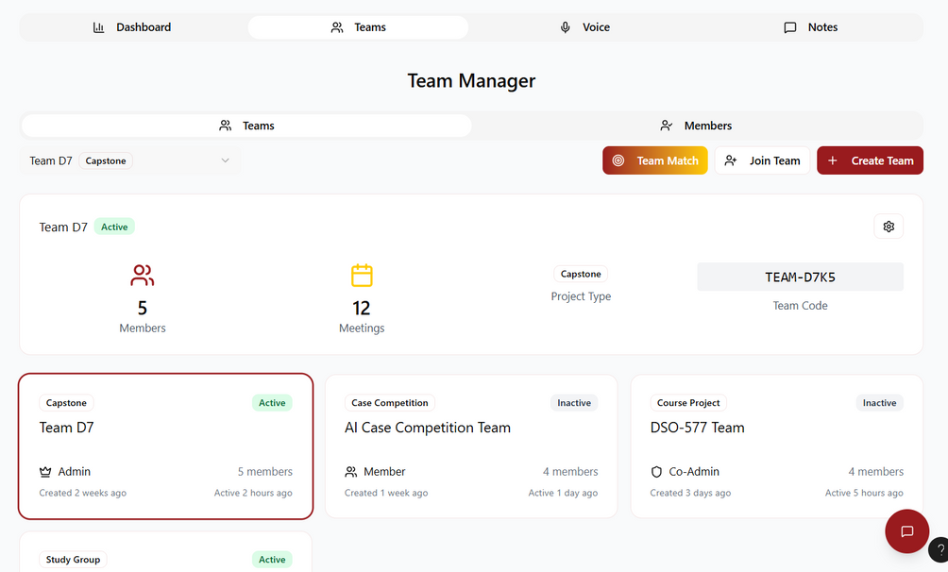
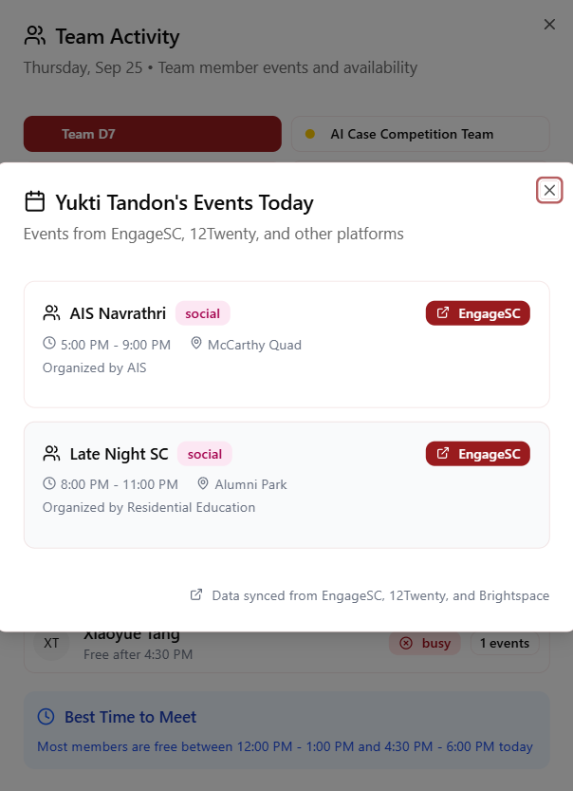
FEATURE 2 DEMO
Teams: Coordination starts here!
TrojanSync

Slide 11
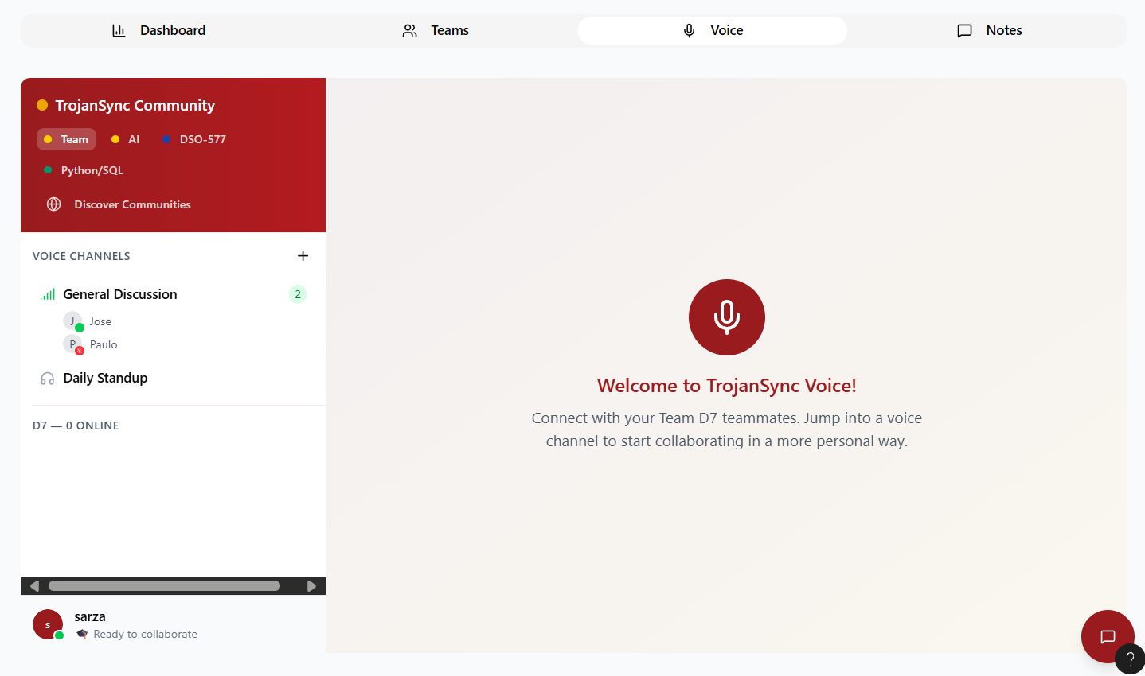
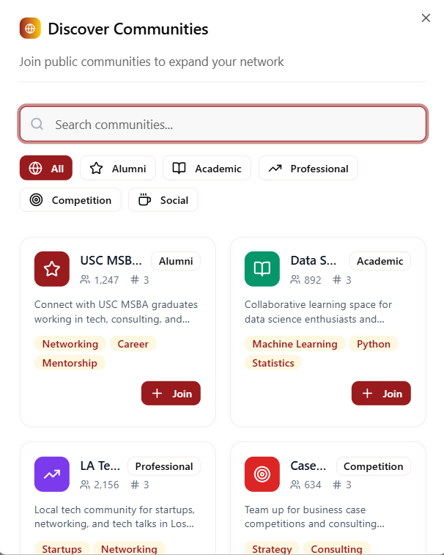
FEATURE 3 DEMO
Voice Channel : Communication is key!
TrojanSync

Slide 12

GUARDRAILS • METRICS • GROWTH
Guardrails
Metrics and Tests
Privacy setting: team visibility, community visibility
USC SSO sign in
Accessibility with disability
70% of MSBA community onboarded
Satisfaction: NPS >= 80%
Median meeting locking time <= 6min
SEQ >= 5.5
WAU >= 50%
Adoption and Growth
Future Improvements
Weekly digest
Buddy RSVP drive
Cohort communications access
Out of scope features: notes template,roles rotation
UI/UX improvement for phone users
Integrate necessary calendars
TrojanSync

Slide 13

IMPLEMENTATION PLAN
TrojanSync
Activate
Prove & Decide
In-class demo
In-person ambassador campaign
App available for download
Lock outcomes
Collect satisfaction
Secure key insights
week 0
week 1
week 2 -3
week 4
SOON
Prep
Build Habit
USC SSO configured test
Integrate necessary calendar
Test run with small group
A/B test: 3 vs 5 suggestions
Test reliability
Gather more data

